Slide 1

SPARK

Slide 2
CONTENTS
Processing data stream using Spark streaming

Slide 3
Overview
Spark Streaming is an extension of the core Spark API that enables scalable, high-throughput, fault-tolerant stream processing of live data streams.
Data can be ingested from many sources like Kafka, Kinesis, or TCP sockets, and can be processed using complex algorithms expressed with high-level functions like map, reduce, join and window.
Finally, processed data can be pushed out to filesystems, databases, and live dashboards. In fact, you can apply Spark’s machine learning and graph processing algorithms on data streams.

Slide 4
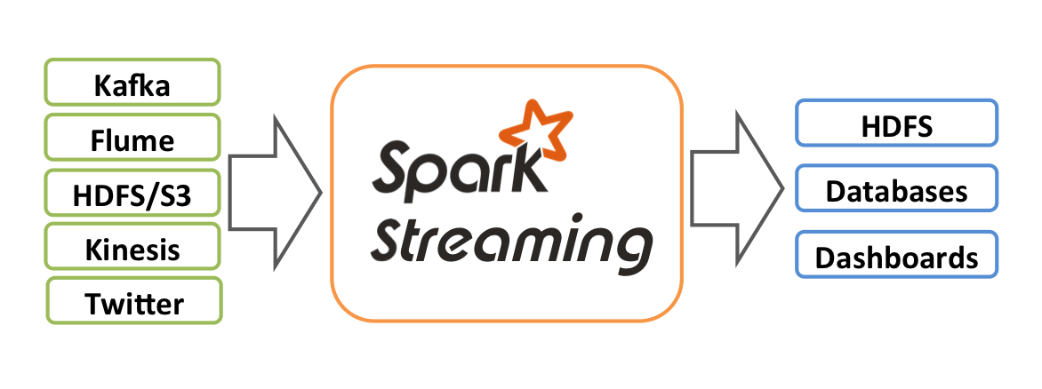
Internally, it works as follows. Spark Streaming receives live input data streams and divides the data into batches, which are then processed by the Spark engine to generate the final stream of results in batches.

Slide 5
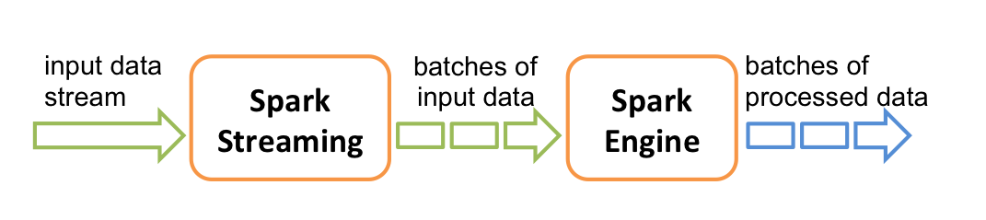
Spark Streaming provides a high-level abstraction called discretized stream or DStream, which represents a continuous stream of data.
DStreams can be created either from input data streams from sources such as Kafka, and Kinesis, or by applying high-level operations on other DStreams. Internally, a DStream is represented as a sequence of RDDs.

Slide 6
A Quick Example
Before we go into the details of how to write your own Spark Streaming program, let’s take a quick look at what a simple Spark Streaming program looks like.
Let’s say we want to count the number of words in text data received from a data server listening on a TCP socket.
All you need to do is as follows.

Slide 7
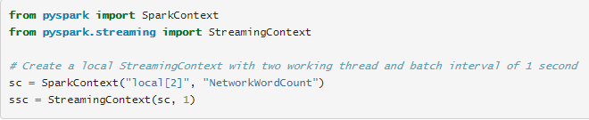
First, we import StreamingContext, which is the main entry point for all streaming functionality. We create a local StreamingContext with two execution threads, and batch interval of 1 second.
Using this context, we can create a DStream that represents streaming data from a TCP source, specified as hostname (e.g. localhost) and port (e.g. 9999).

Slide 8


This lines DStream represents the stream of data that will be received from the data server. Each record in this DStream is a line of text. Next, we want to split the lines by space into words.

Slide 9
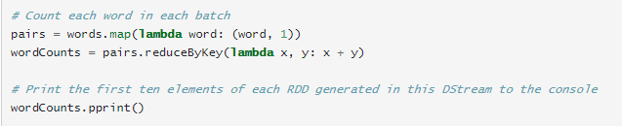
flatMap is a one-to-many DStream operation that creates a new DStream by generating multiple new records from each record in the source DStream.
In this case, each line will be split into multiple words and the stream of words is represented as the words DStream. Next, we want to count these words.

Slide 10

The words DStream is further mapped (one-to-one transformation) to a DStream of (word, 1) pairs, which is then reduced to get the frequency of words in each batch of data. Finally, wordCounts.pprint() will print a few of the counts generated every second.
Note that when these lines are executed, Spark Streaming only sets up the computation it will perform when it is started, and no real processing has started yet. To start the processing after all the transformations have been setup, we finally call

Slide 11

The complete code can be found in the Spark Streaming example NetworkWordCount.
If you have already downloaded and built Spark, you can run this example as follows. You will first need to run Netcat (a small utility found in most Unix-like systems) as a data server by using

Slide 12
Then, in a different terminal, you can start the example by using
Then, any lines typed in the terminal running the netcat server will be counted and printed on screen every second.
It will look something like the following.

Slide 13
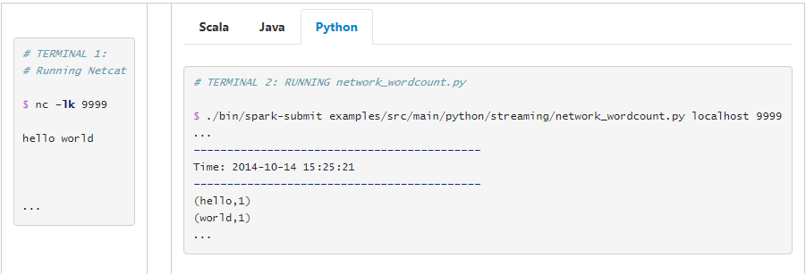

Slide 14
Basic Concepts
Next, we move beyond the simple example and elaborate on the basics of Spark Streaming.
Linking
Similar to Spark, Spark Streaming is available through Maven Central. To write your own Spark Streaming program, you will have to add the following dependency to your SBT or Maven project.

Slide 15
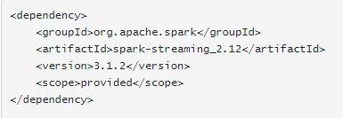
For ingesting data from sources like Kafka and Kinesis that are not present in the Spark Streaming core API, you will have to add the corresponding artifact spark-streaming-xyz_2.12 to the dependencies. For example, some of the common ones are as follows.

Slide 16
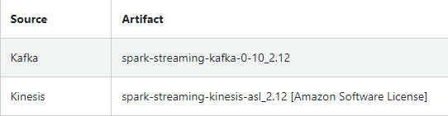

Slide 17
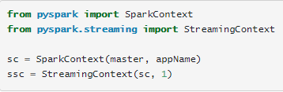
Initializing StreamingContext
To initialize a Spark Streaming program, a StreamingContext object has to be created which is the main entry point of all Spark Streaming functionality.
A StreamingContext object can be created from a SparkContext object.

Slide 18
The appName parameter is a name for your application to show on the cluster UI. master is a Spark, Mesos or YARN cluster URL, or a special “local[*]” string to run in local mode.
In practice, when running on a cluster, you will not want to hardcode master in the program, but rather launch the application with spark-submit and receive it there.
However, for local testing and unit tests, you can pass “local[*]” to run Spark Streaming in-process (detects the number of cores in the local system).
The batch interval must be set based on the latency requirements of your application and available cluster resources.

Slide 19
After a context is defined, you have to do the following.
Define the input sources by creating input DStreams.
Define the streaming computations by applying transformation and output operations to DStreams.
Start receiving data and processing it using streamingContext.start().
Wait for the processing to be stopped (manually or due to any error) using streamingContext.awaitTermination().
The processing can be manually stopped using streamingContext.stop().

Slide 20
Points to remember:
Once a context has been started, no new streaming computations can be set up or added to it.
Once a context has been stopped, it cannot be restarted.
Only one StreamingContext can be active in a JVM at the same time.
stop() on StreamingContext also stops the SparkContext. To stop only the StreamingContext, set the optional parameter of stop() called stopSparkContext to false.
A SparkContext can be re-used to create multiple StreamingContexts, as long as the previous StreamingContext is stopped (without stopping the SparkContext) before the next StreamingContext is created.

Slide 21
Discretized Streams (DStreams)
Discretized Stream or DStream is the basic abstraction provided by Spark Streaming. It represents a continuous stream of data, either the input data stream received from source, or the processed data stream generated by transforming the input stream.
Internally, a DStream is represented by a continuous series of RDDs, which is Spark’s abstraction of an immutable, distributed dataset.

Slide 22
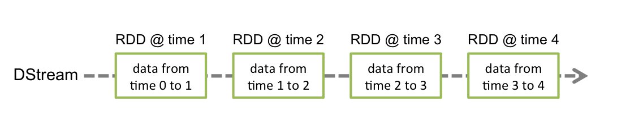
Any operation applied on a DStream translates to operations on the underlying RDDs. For example, in the earlier example of converting a stream of lines to words, the flatMap operation is applied on each RDD in the lines DStream to generate the RDDs of the words DStream.
This is shown in the following figure.

Slide 23
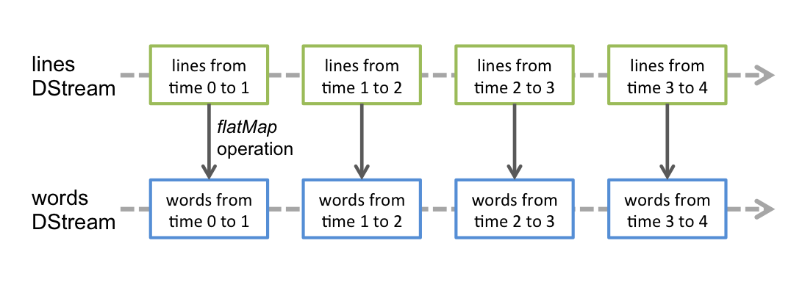
These underlying RDD transformations are computed by the Spark engine.
The DStream operations hide most of these details and provide the developer with a higher-level API for convenience.

Slide 24
Transformations on DStreams
Similar to that of RDDs, transformations allow the data from the input DStream to be modified.
DStreams support many of the transformations available on normal Spark RDD’s. Some of the common ones are as follows.

Slide 25
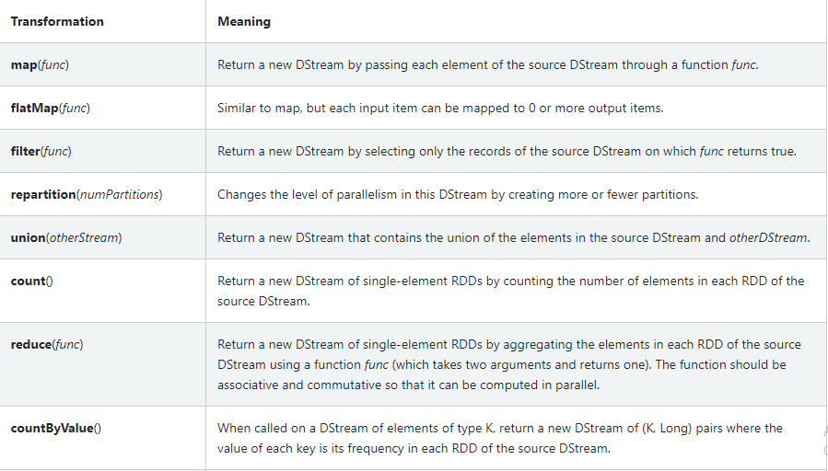

Slide 26
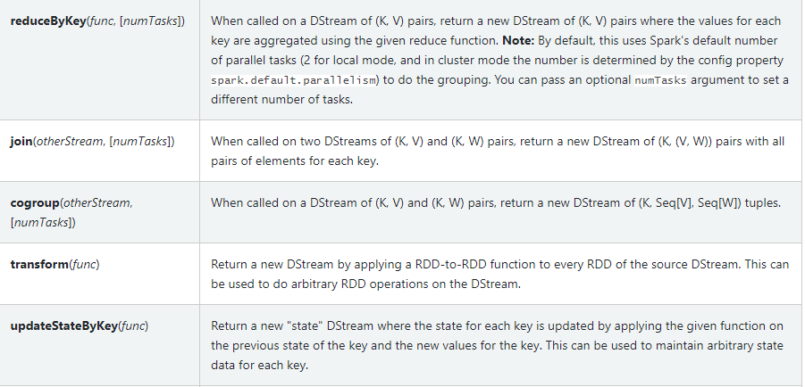

Slide 27
A few of these transformations are worth discussing in more detail.
UpdateStateByKey Operation
The updateStateByKey operation allows you to maintain arbitrary state while continuously updating it with new information. To use this, you will have to do two steps.
Define the state - The state can be an arbitrary data type.
Define the state update function - Specify with a function how to update the state using the previous state and the new values from an input stream.

Slide 28
Transform Operation
The transform operation (along with its variations like transformWith) allows arbitrary RDD-to-RDD functions to be applied on a DStream.
It can be used to apply any RDD operation that is not exposed in the DStream API. For example, the functionality of joining every batch in a data stream with another dataset is not directly exposed in the DStream API.
However, you can easily use transform to do this. This enables very powerful possibilities.
For example, one can do real-time data cleaning by joining the input data stream with precomputed spam information (maybe generated with Spark as well) and then filtering based on it.

Slide 29


Slide 30
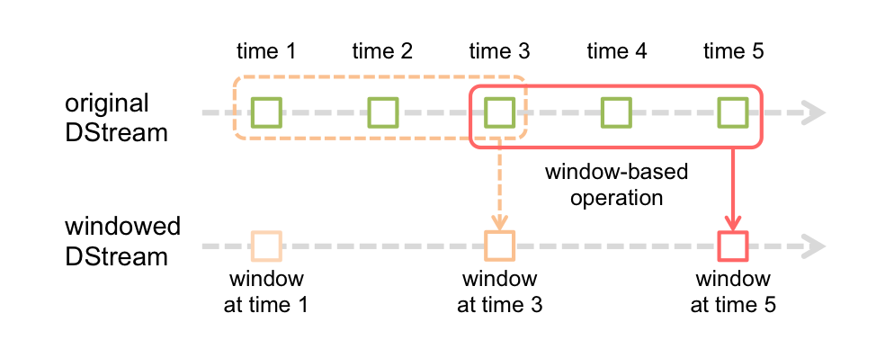
Window Operations
Spark Streaming also provides windowed computations, which allow you to apply transformations over a sliding window of data.
The following figure illustrates this sliding window.

Slide 31
This shows that any window operation needs to specify two parameters.
window length - The duration of the window (3 in the figure).
sliding interval - The interval at which the window operation is performed (2 in the figure).
These two parameters must be multiples of the batch interval of the source DStream.
Let’s illustrate the window operations with an example. Say, you want to extend the earlier example by generating word counts over the last 30 seconds of data, every 10 seconds.
To do this, we have to apply the reduceByKey operation on the pairs DStream of (word, 1) pairs over the last 30 seconds of data. This is done using the operation reduceByKeyAndWindow.

Slide 32
Some of the common window operations are as follows. All of these operations take the said two parameters - windowLength and slideInterval.

Slide 33
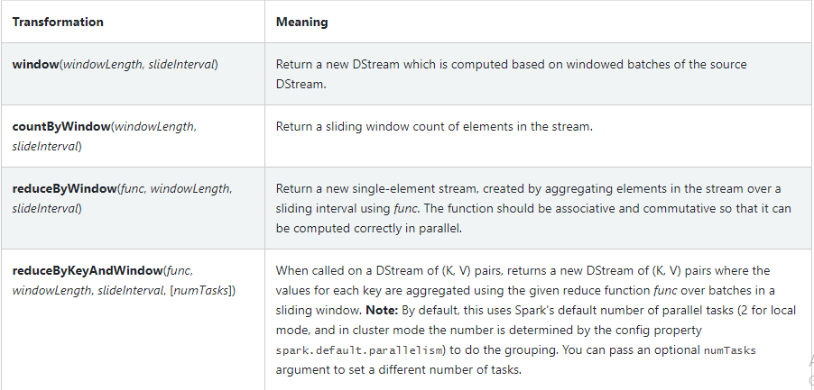

Slide 34
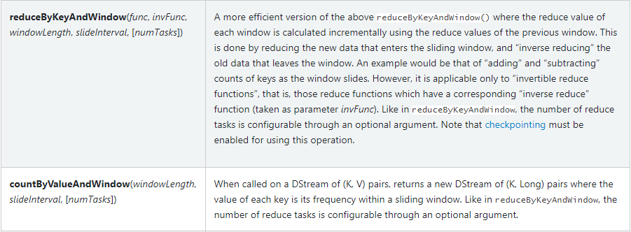

Slide 35

Join Operations
Finally, its worth highlighting how easily you can perform different kinds of joins in Spark Streaming.
Stream-stream joins
Streams can be very easily joined with other streams.

Slide 36

Here, in each batch interval, the RDD generated by stream1 will be joined with the RDD generated by stream2.
You can also do leftOuterJoin, rightOuterJoin, fullOuterJoin.
Furthermore, it is often very useful to do joins over windows of the streams. That is pretty easy as well.

Slide 37

Stream-dataset joins
This has already been shown earlier while explain DStream.transform operation.
Here is yet another example of joining a windowed stream with a dataset.

Slide 38
Output Operations on DStreams
Output operations allow DStream’s data to be pushed out to external systems like a database or a file systems.
Since the output operations actually allow the transformed data to be consumed by external systems, they trigger the actual execution of all the DStream transformations (similar to actions for RDDs).
Currently, the following output operations are defined:

Slide 39
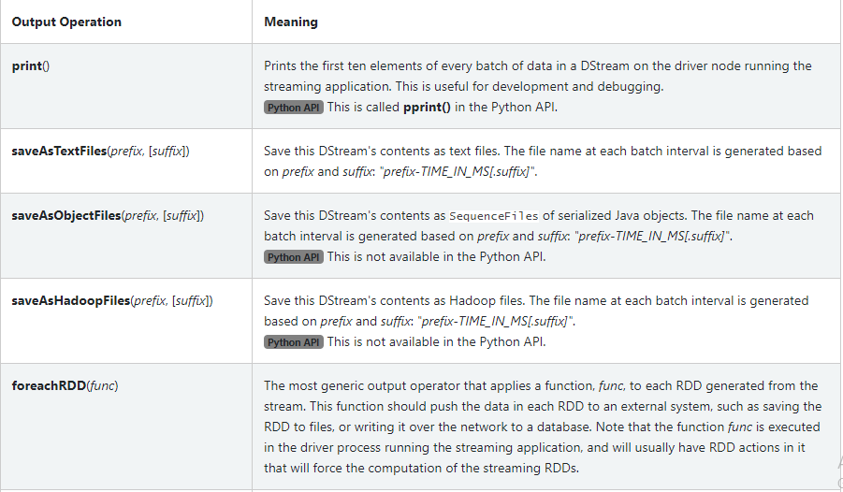

Slide 40
DataFrame and SQL Operations
You can easily use DataFrames and SQL operations on streaming data.
You have to create a SparkSession using the SparkContext that the StreamingContext is using. Furthermore, this has to done such that it can be restarted on driver failures.
This is done by creating a lazily instantiated singleton instance of SparkSession. This is shown in the following example.
It modifies the earlier word count example to generate word counts using DataFrames and SQL. Each RDD is converted to a DataFrame, registered as a temporary table and then queried using SQL.

Slide 41
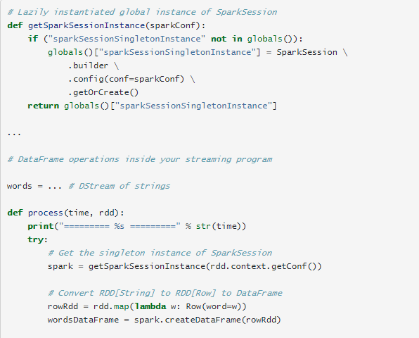

Slide 42
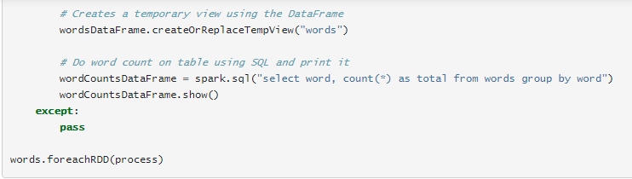

Slide 43
Accumulators, Broadcast Variables, and Checkpoints
Accumulators and Broadcast variables cannot be recovered from checkpoint in Spark Streaming.
If you enable checkpointing and use Accumulators or Broadcast variables as well, you’ll have to create lazily instantiated singleton instances for Accumulators and Broadcast variables so that they can be re-instantiated after the driver restarts on failure.
This is shown in the following example.

Slide 44
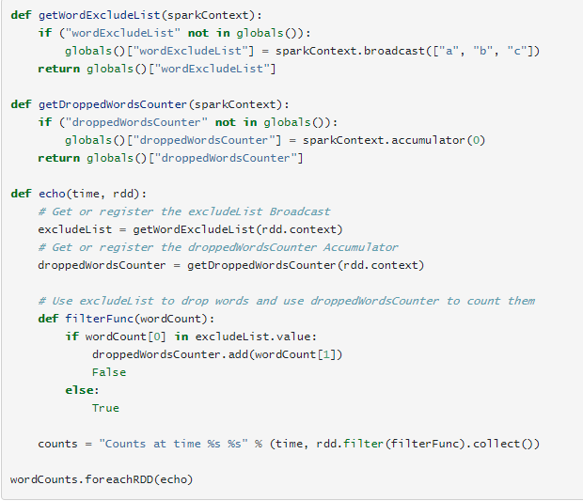

Slide 45
Deploying Applications
This section discusses the steps to deploy a Spark Streaming application.
Requirements
To run a Spark Streaming applications, you need to have the following.
Cluster with a cluster manager - This is the general requirement of any Spark application, and discussed in detail in the deployment guide.

Slide 46
Package the application JAR - You have to compile your streaming application into a JAR. If you are using spark-submit to start the application, then you will not need to provide Spark and Spark Streaming in the JAR. However, if your application uses advanced sources (e.g. Kafka), then you will have to package the extra artifact they link to, along with their dependencies, in the JAR that is used to deploy the application. For example, an application using KafkaUtils will have to include spark-streaming-kafka-0-10_2.12 and all its transitive dependencies in the application JAR.
Configuring sufficient memory for the executors - Since the received data must be stored in memory, the executors must be configured with sufficient memory to hold the received data. Note that if you are doing 10 minute window operations, the system has to keep at least last 10 minutes of data in memory. So the memory requirements for the application depends on the operations used in it.

Slide 47
Configuring automatic restart of the application driver - To automatically recover from a driver failure, the deployment infrastructure that is used to run the streaming application must monitor the driver process and relaunch the driver if it fails. Different cluster managers have different tools to achieve this.
Spark Standalone - A Spark application driver can be submitted to run within the Spark Standalone cluster (see cluster deploy mode), that is, the application driver itself runs on one of the worker nodes. Furthermore, the Standalone cluster manager can be instructed to supervise the driver, and relaunch it if the driver fails either due to non-zero exit code, or due to failure of the node running the driver. See cluster mode and supervise in the Spark Standalone guide for more details.
YARN - Yarn supports a similar mechanism for automatically restarting an application. Please refer to YARN documentation for more details.
Mesos - Marathon has been used to achieve this with Mesos.

Slide 48
Configuring checkpointing - If the stream application requires it, then a directory in the Hadoop API compatible fault-tolerant storage (e.g. HDFS, S3, etc.) must be configured as the checkpoint directory and the streaming application written in a way that checkpoint information can be used for failure recovery. See the checkpointing section for more details
Setting the max receiving rate - If the cluster resources is not large enough for the streaming application to process data as fast as it is being received, the receivers can be rate limited by setting a maximum rate limit in terms of records / sec. See the configuration parameters spark.streaming.receiver.maxRate for receivers and spark.streaming.kafka.maxRatePerPartition for Direct Kafka approach. In Spark 1.5, we have introduced a feature called backpressure that eliminate the need to set this rate limit, as Spark Streaming automatically figures out the rate limits and dynamically adjusts them if the processing conditions change.

Slide 49
Semantics of output operations
Output operations (like foreachRDD) have at-least once semantics, that is, the transformed data may get written to an external entity more than once in the event of a worker failure.
While this is acceptable for saving to file systems using the saveAs***Files operations (as the file will simply get overwritten with the same data), additional effort may be necessary to achieve exactly-once semantics.
There are two approaches.

Slide 50
Idempotent updates: Multiple attempts always write the same data. For example, saveAs***Files always writes the same data to the generated files.
Transactional updates: All updates are made transactionally so that updates are made exactly once atomically. One way to do this would be the following.

Slide 51
Use the batch time (available in foreachRDD) and the partition index of the RDD to create an identifier. This identifier uniquely identifies a blob data in the streaming application.
Update external system with this blob transactionally (that is, exactly once, atomically) using the identifier. That is, if the identifier is not already committed, commit the partition data and the identifier atomically. Else, if this was already committed, skip the update.

Slide 52
Use the batch time (available in foreachRDD) and the partition index of the RDD to create an identifier. This identifier uniquely identifies a blob data in the streaming application.
Update external system with this blob transactionally (that is, exactly once, atomically) using the identifier. That is, if the identifier is not already committed, commit the partition data and the identifier atomically. Else, if this was already committed, skip the update.

Slide 53
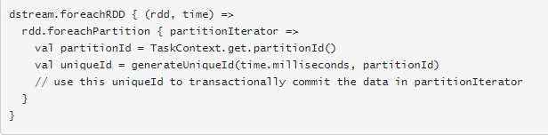

Slide 54
END OF SESSION
Q&A

